Slide 1
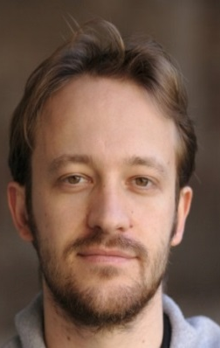
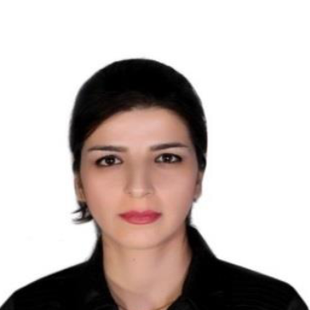
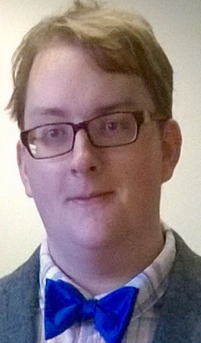
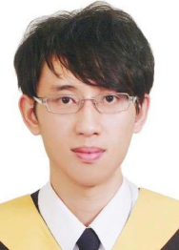

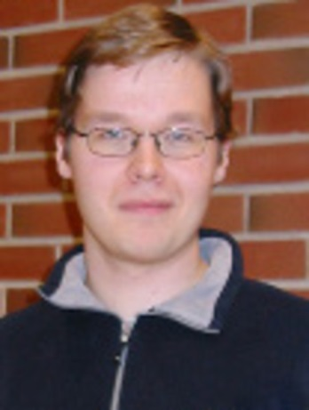

Superconducting qubit for quantum thermodynamics experiments
Jukka Pekola, Aalto University, Helsinki, Finland
Outline:
1. Measuring heat current in a circuit, thermometry
2. Experiment on quantum heat switch A. Ronzani et al., arxiv:1801.09312
3. On-going work and future:
qubit heat engines and refrigerators
single microwave photon detection
Alberto Ronzani
Bayan
Karimi
Yu-Cheng
Chang
ChiiDong
Chen
Joonas
Peltonen
Jorden
Senior

Slide 2
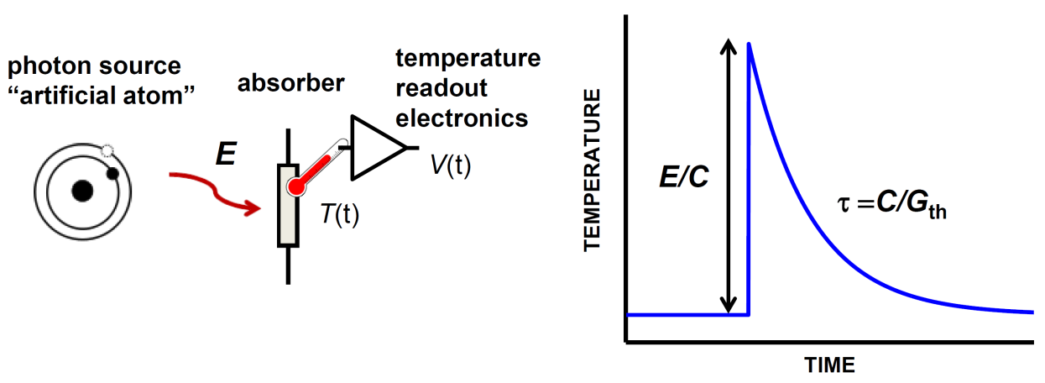
Measuring heat currents
Steady-state heating (”bolometer”)
Response to a heat pulse (”calorimeter”)
I_{h}
C,T_{bath}+ΔT
ΔT=
I_{h}/G_{th}
G_{th}
T_{bath}
ΔT

Slide 3
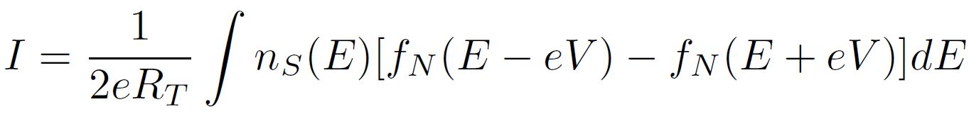
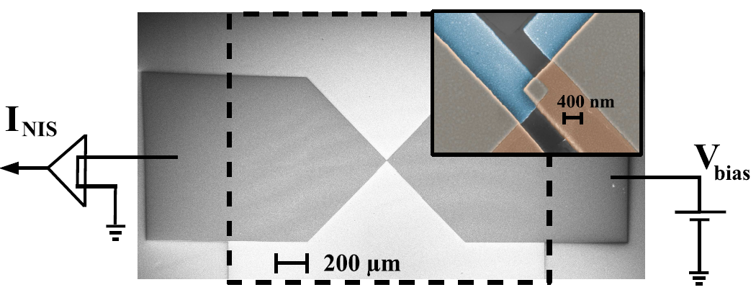
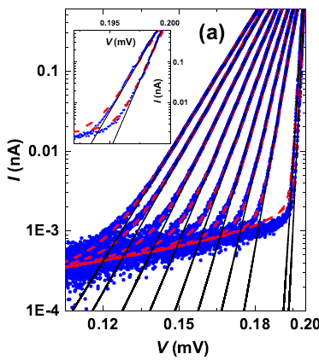
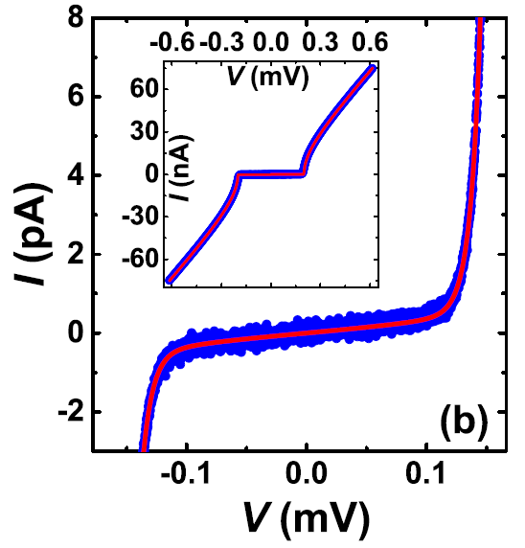
NIS-thermometry
Probes electron temperature of N island (and not of S!)
Phys. Rev. Appl. 4, 034001 (2015).

Slide 4
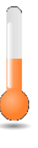
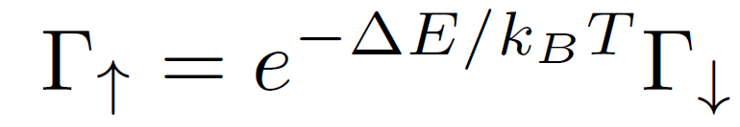
Temperature of a qubit?
BATH
T
Couple the qubit to a true thermal bath

Slide 5
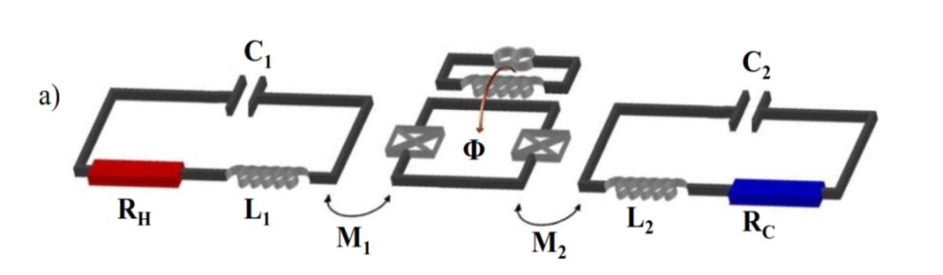
Experiment on quantum heat switch
A. Ronzani et al., arxiv:1801.09312
R_{H}
P_{C}
Φ
qubit
P_{C}
R_{C}
B. Karimi, J. Pekola, M. Campisi, and R. Fazio, Quantum Science and Technology 2, 044007 (2017).

Slide 6
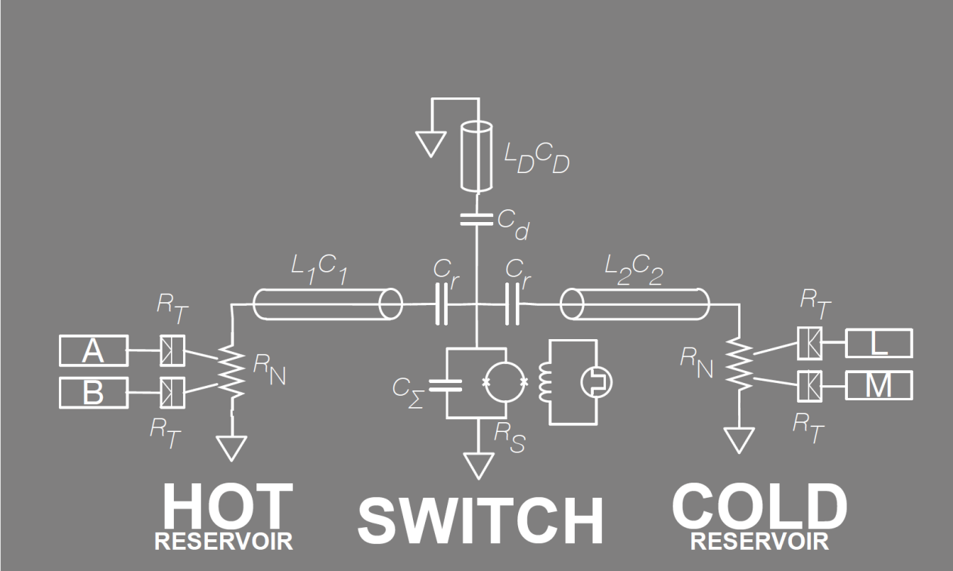
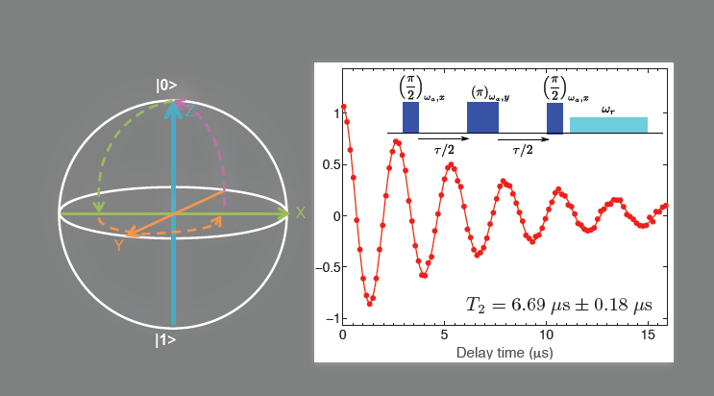
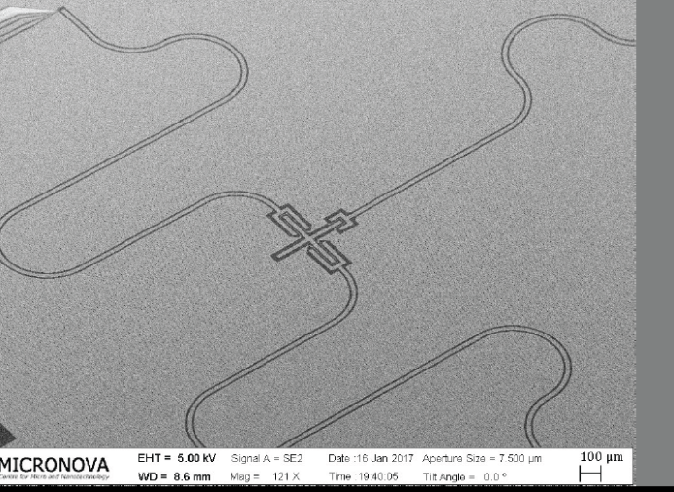
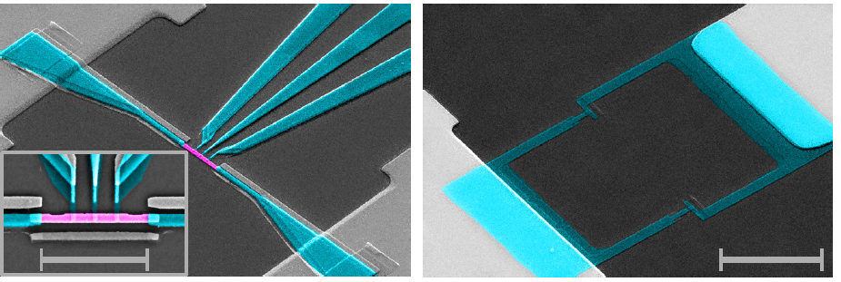
Experimental realization
QUBIT WITHOUT ABSORBERS
10 μm
3 μm
1 mm
TRANSMON QUBIT
RESERVOIR AND THERMOMETERS

Slide 7
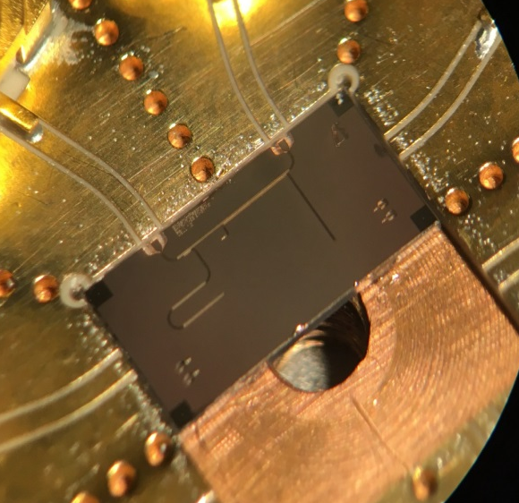
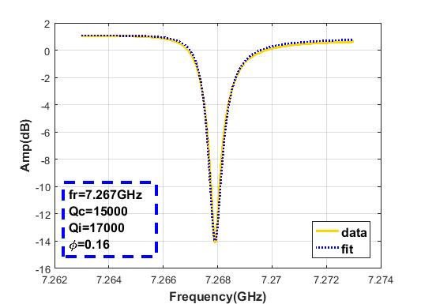
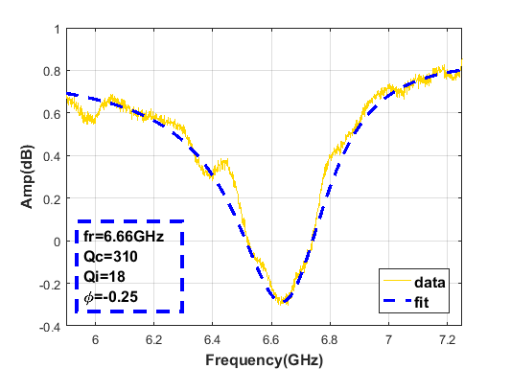
Shunted λ / 4 resonators, measurement of Q
Q = Z₀ / R
R ≈ 2 Ω
Superconducting shunt, Q = 17 000
Normal (copper) shunt, Q = 18
Notes:
E:\Matlab\data\SNSshuntResonatorV4_20171125-12\Fig2.m

Slide 8
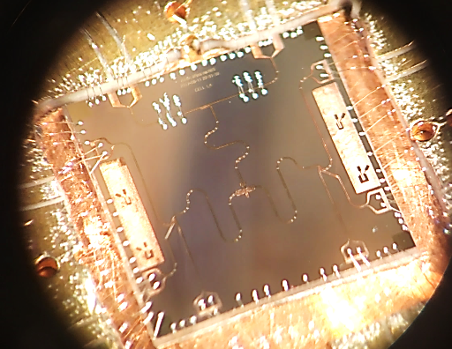
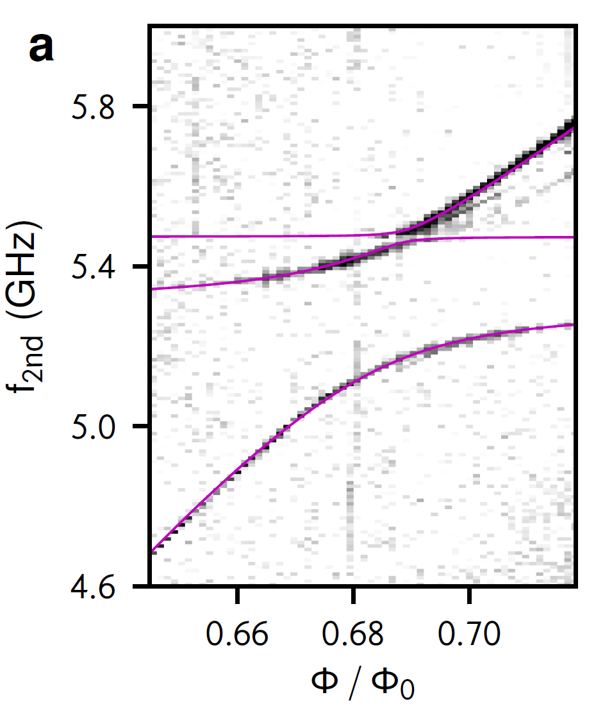
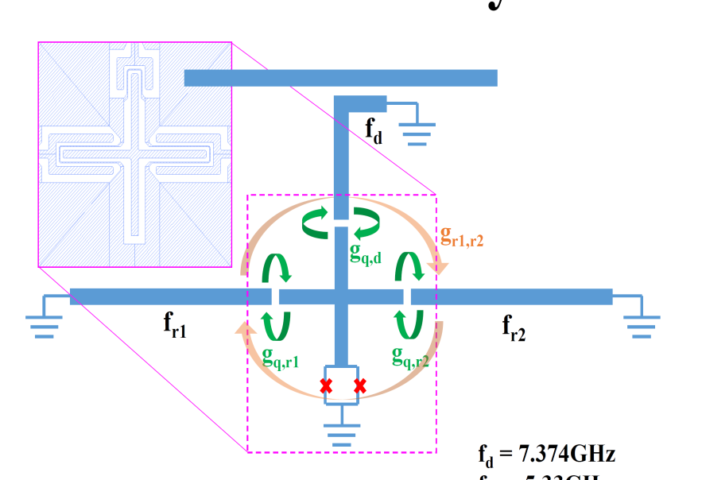
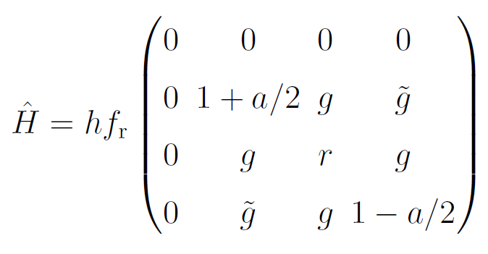
Spectroscopy to determine circuit parameters
f_{r} = 5.39 GHz
g = 0.020
g = - 0.015
a = 0.008
Two tone spectroscopy
r = f_{qubit}/f_{r}

Slide 9
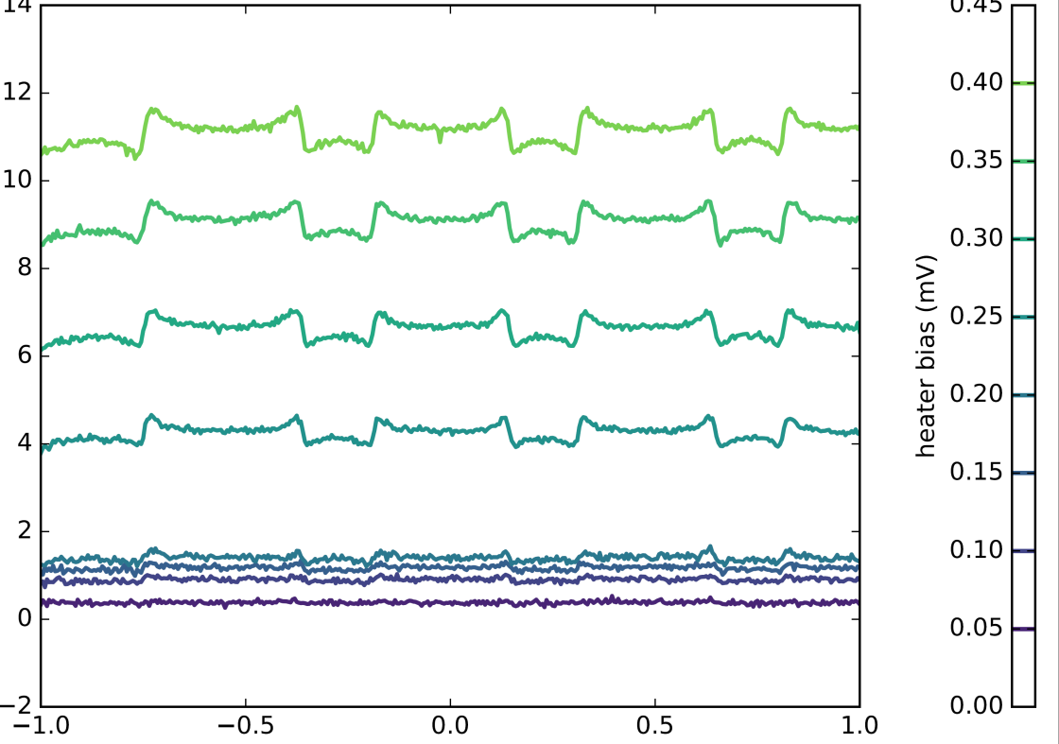
Experimental observation, samples I and II
ΔT (mK)
Q ≈ 20
Q ≈ 3
magnetic flux magnetic flux

Slide 10
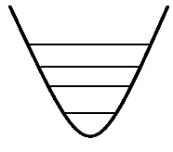

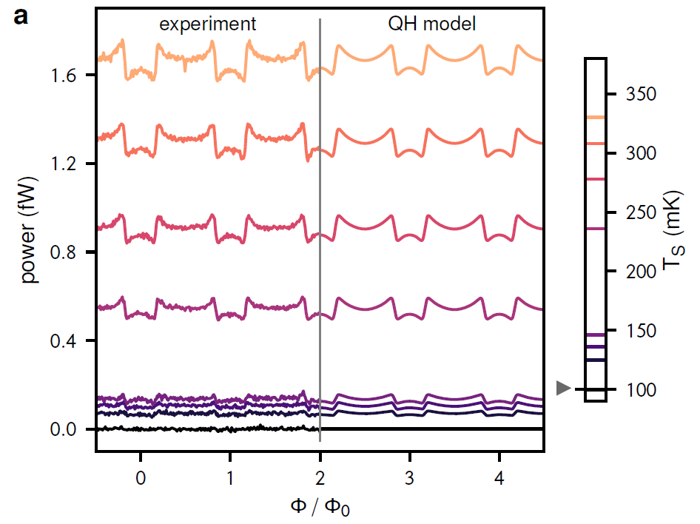
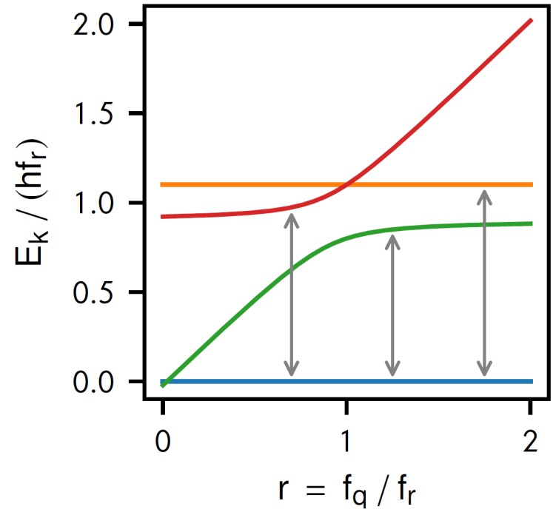
Theory vs experiment: sample I
R_{H}
R_{C}
g’ ∼ Q⁻¹
g
g
g’ ∼ Q⁻¹
Resonator SQUID Resonator
gQ ~ 1, ”quasi-Hamiltonian” model works

Slide 11

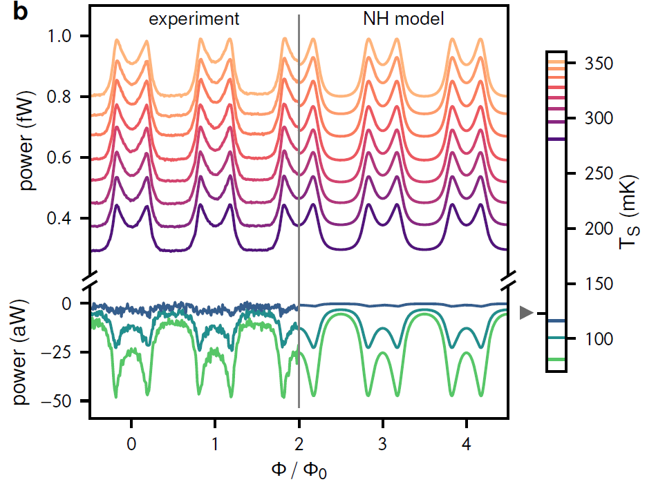
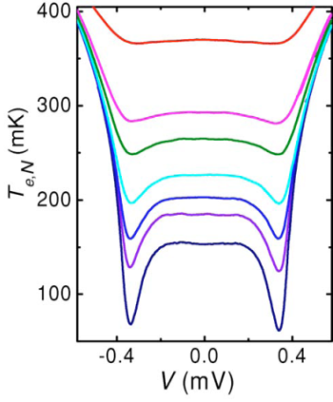
Theory vs experiment: sample II
R_{H}
R_{C}
g’ ∼ Q⁻¹
g
g
g’ ∼ Q⁻¹
Resonator SQUID Resonator
gQ << 1, ”non-Hamiltonian” model works
Cooling at distance of 4 mm by mw photons

Slide 12

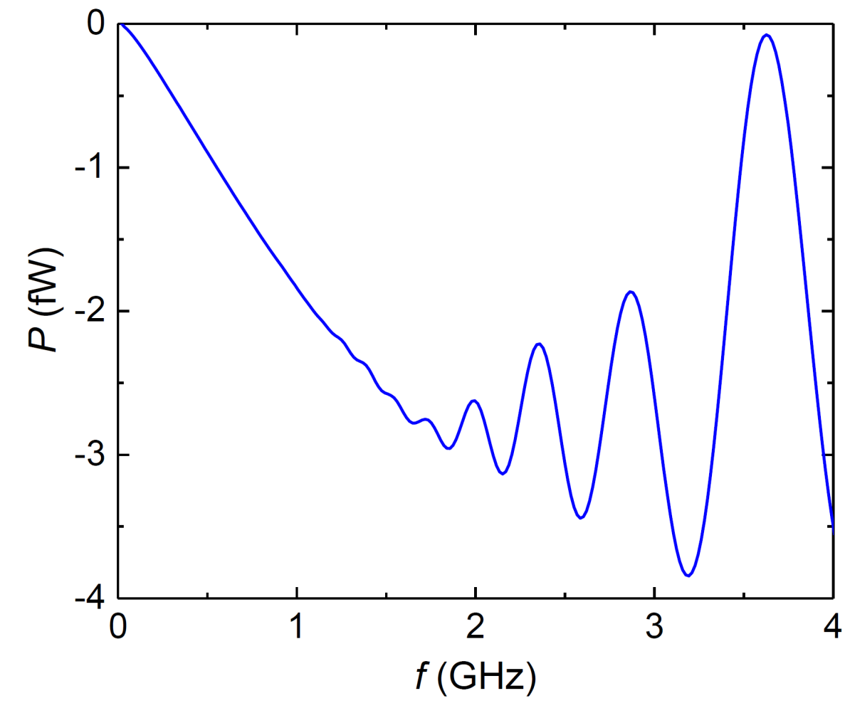
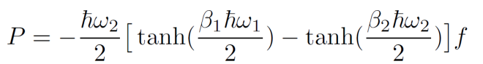
Qubit as a quantum refrigerator
R_{H}
Q₁
W
qubit
- Q₂
R_{C}
A. Niskanen, Y. Nakamura, JP, PRB 76, 174523 (2007); B. Karimi and JP, PRB 94, 184503 (2016).

Slide 13
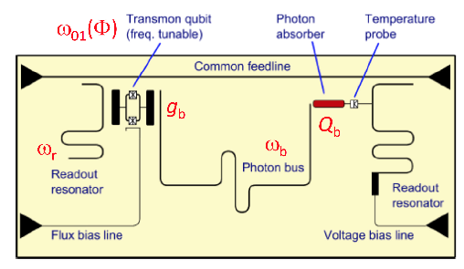
Stochastic thermodynamics of a driven qubit
Frank Hekking and JP, PRL 111, 093602 (2013); Horowitz and Parrondo, NJP 15, 085028 (2013)
Classical evolution
Quantum evolution
g
g
TIME

Slide 14
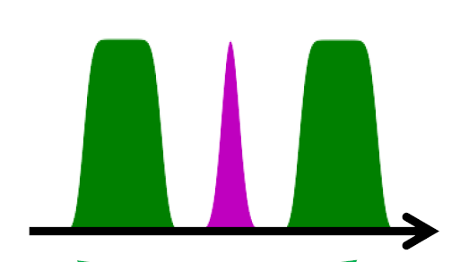
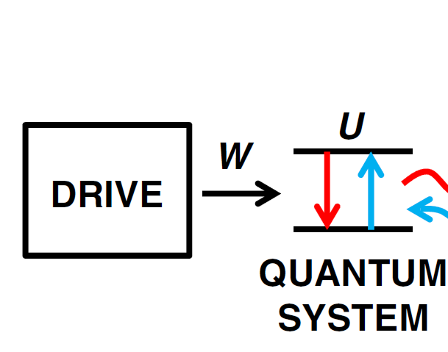
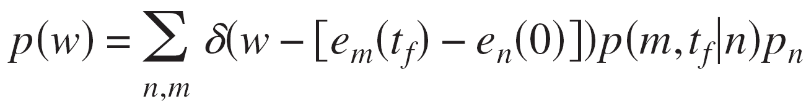
Work measurement in a quantum system
Two-measurement protocol (TMP):
W = E_{f} – E_{i}
J. Kurchan, 2000
Since W = ΔU + Q, and ΔU = E_{f} – E_{i} , this measurement works only for a closed system
TIME
QUBIT OPERATION
1st MEASUREMENT
2nd MEASUREMENT
Kurchan 2000, Talkner et al. 2007

Slide 15





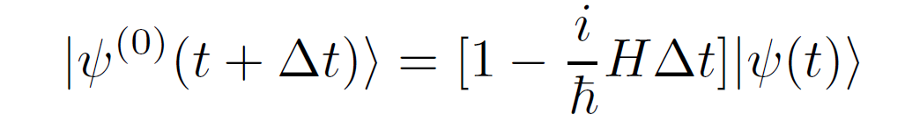
Quantum trajectories
Objective: unravel into single realizations (”single experiments”) instead of averages (the latter ones come naturally from the density matrix)
Construct the Monte Carlo wave function (MCWF) for the system
Dalibard, Castin and Mölmer 1992
Plenio and Knight 1998
At t = t + Δt, we have three possibilities:
Relaxation with probability
2. Excitation with probability
3. Evolution without photon absorption/emission
Here the Hamiltonian is non-hermitian (to preserve the norm)

Slide 16
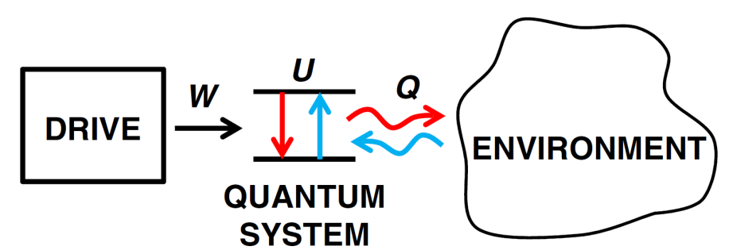
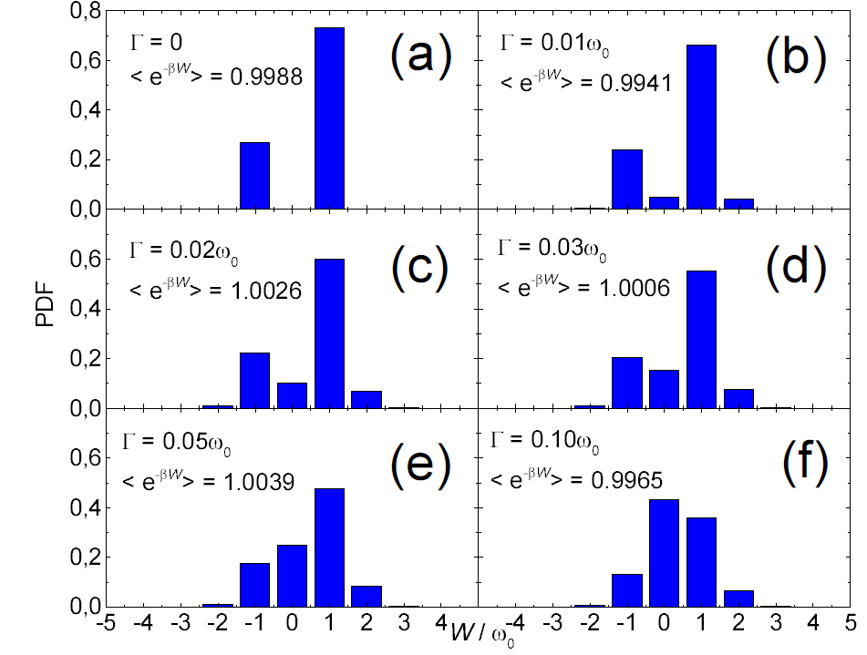
Quantum jump approach for analyzing distribution of dissipation
We apply the jump method to a driven qubit
π pulse with dissipation
F. Hekking and JP, PRL 111, 093602 (2013).

Slide 17
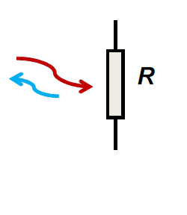


Calorimetry for measuring mw photons
Requirements for calorimetry on single microwave quantum level. Photons from relaxation of a superconducting qubit.
photon source
“artificial atom”
temperature
readout
electronics
Typical parameters:
Operating temperature
T = 0.1 K
E/k_{B} = 1 K, C = 300...1000k_{B}
ΔT ~ 1 - 3 mK, τ ~ 0.01 - 1 ms
NET = 10 μK/(Hz)^{1/2} is sufficient for single photon detection
δE = NET (C G_{th})^{1/2}
JP, P. Solinas, A. Shnirman, and D. V. Averin., NJP 15, 115006 (2013).
absorber
E
V(t)
T(t)

Slide 18
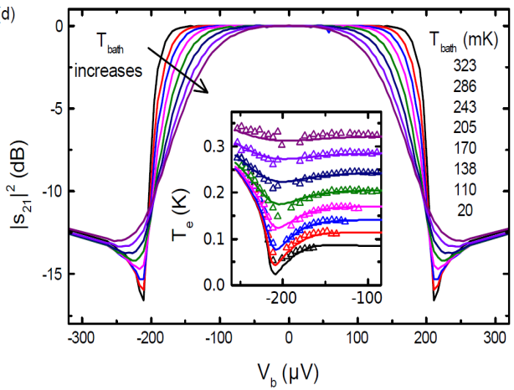
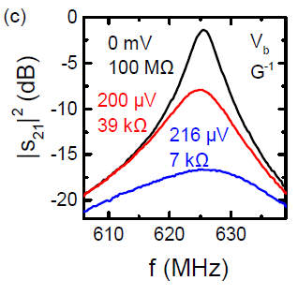
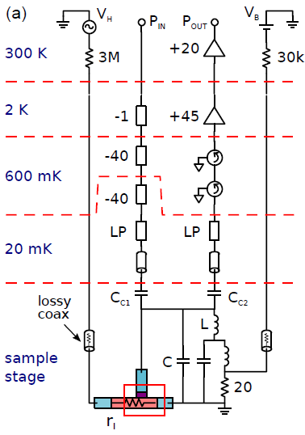
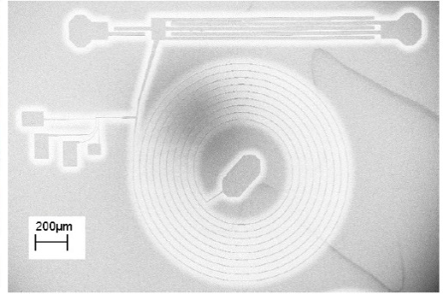
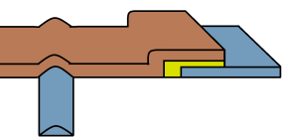
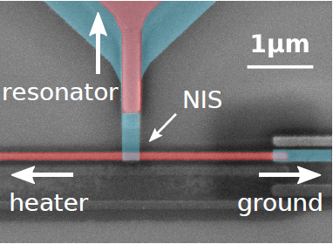
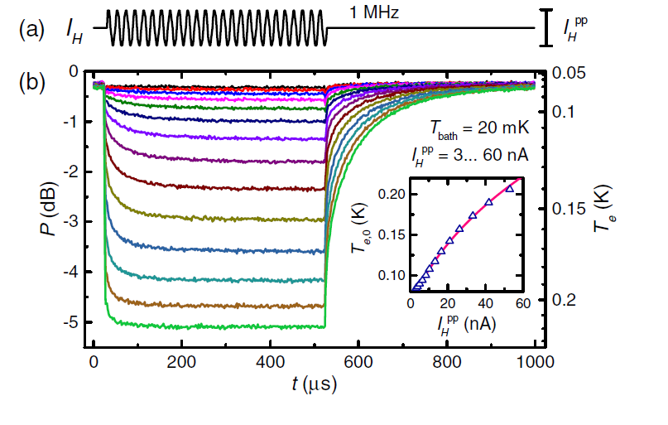
Fast NIS thermometry on electrons
Read-out at 600 MHz of a NIS junction, 10 MHz bandwidth
S. Gasparinetti et al., Phys. Rev. Applied 3, 014007 (2015); B. Karimi et al., in preparation

Slide 19



Summary
Measurement of heat currents in circuits
Quantum heat switch based on a superconducting qubit realized and analyzed; two regimes of operation observed depending on the gQ value
arxiv:1801.09312
Quantum refrigerators and heat engines and stochastic quantum thermodynamics are envisioned based on superconducting qubits and thermometry/calorimetry

Slide 20
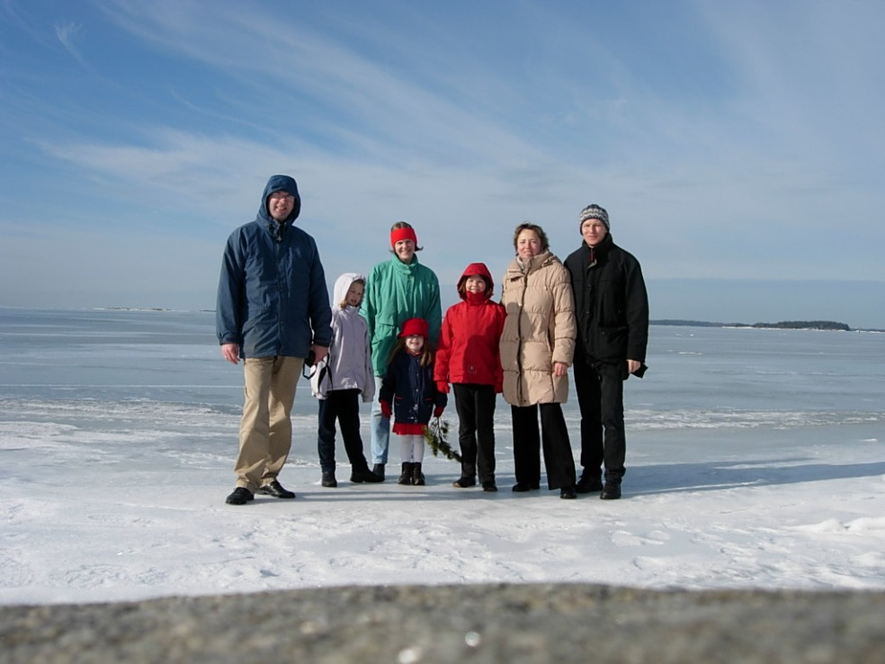
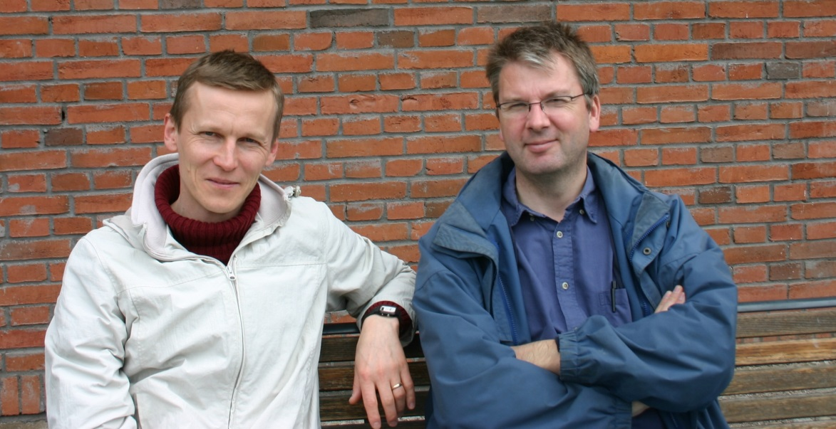
Frank in Finland
Helsinki 2005
Photos:
Erika Börsje-Hekking

